Slide 1
WELCOME TO OUR PRESENTATION

Slide 2
SUPERVISED BY
Blockchain-based Teaching Evaluation System for Ensuring Data Integrity and Anonymity
Md. Mijanur Rahman
Assistant Professor
Department of Computer Science & Engineering
Southeast University

Slide 3



OUR TEAM
Uttam Kumar Saha
ID: 2019000000028
Shohedul Islam ID : 2019000000014
Sanjida Akther ID: 2019000000008

Slide 4
OUTLINES
Introduction
Problem Statement
Research Objective
Literature Review
Methodology
Implementation
Result and Discussion
Conclusion and future work
Reference

Slide 5
INTRODUCTION
** Importance of Student feedback system
** Existing problems
** Proposed solution
** Our contribution

Slide 6
PROBLEM STATEMENT
Traditional feedback system fail to guarantee anonymity.
Tempering with feedback
Less secure
Candidates feel hesitations while giving honest feedback
Administrator remove negative feedback from the system
Existing blockchain based feedback system does not provide proper authentication or password encryption and decryption process.
Existing blockchain based student feedback system did not measure the performance of faculty in a course.
There is no implementation of blockchain based student feedback system

Slide 7
RESEARCH OBJECTIVE
Enhance the security of student feedback system
Secure the data from tempering
Ensure anonymity of each user
1
3
5
2
4
Make authentication process more reliable
Make teaching evaluation process more secure and reliable.

Slide 8
LITERATURE REVIEW
A number of studies have been conducted on feedback system using blockchain technology.
M. M. Rahman et al. introduced a feedback system using blockchain technology which ensures anonymity features of users. It also ensures that given feedback cannot be altered or deleted and only registered users can give the feedback[3]
In 2019, Atharv Chandratre & Shubham Garg proposed a course feedback system based on blockchain technology. In this system they used Ethereum blockchain to ensures the integrity of the recorded data. A Survey management system is used to increase the permanency and traceability[4]

Slide 9




METHODOLOGY

Slide 10
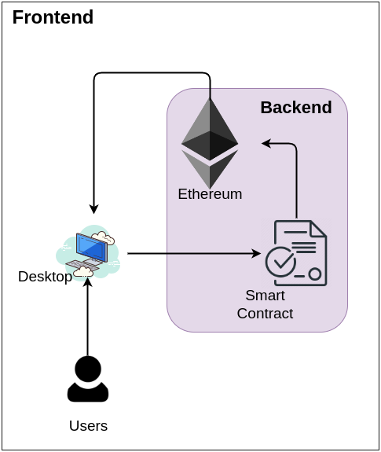
SYSTEM ARCHITECTURE

Slide 11
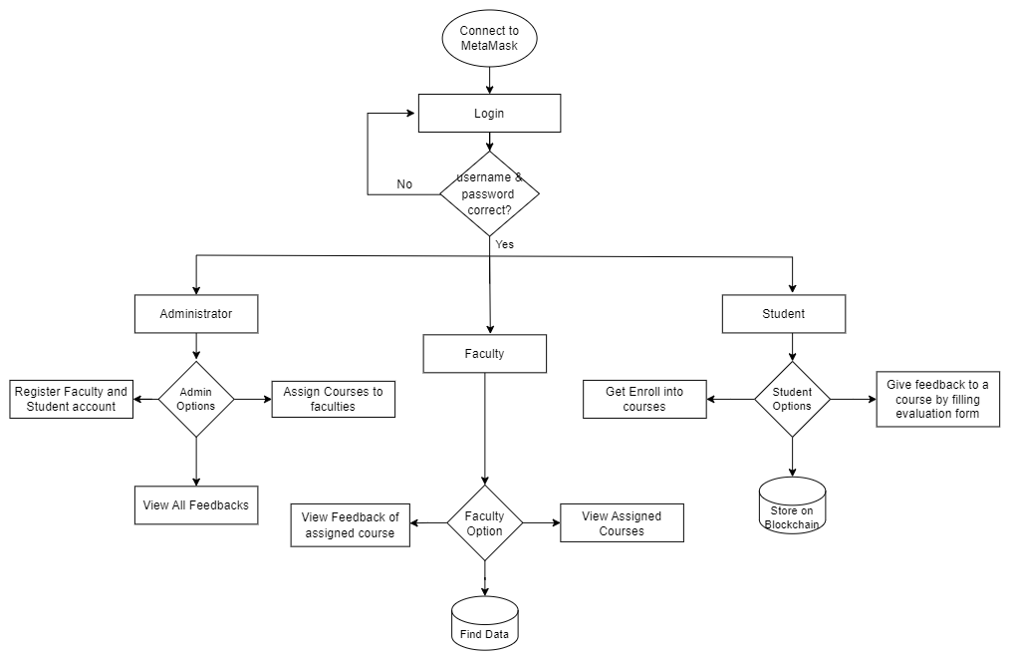
FLOWCHART OF OUR PROPOSED SYSTEM

Slide 12
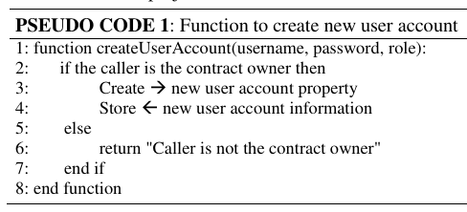
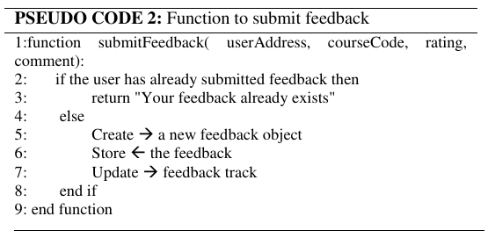
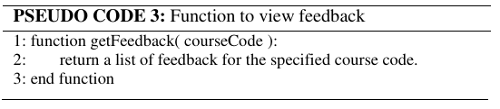
IMPLEMENTATION
https://github.com/uttamsaha/Web3-Student-Feedback-System

Slide 13
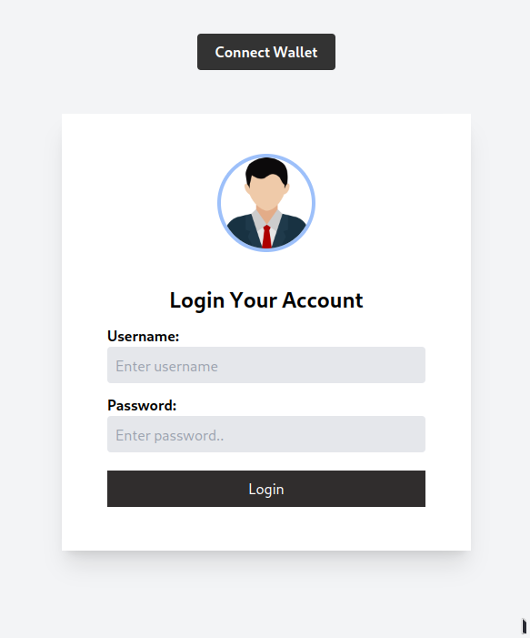
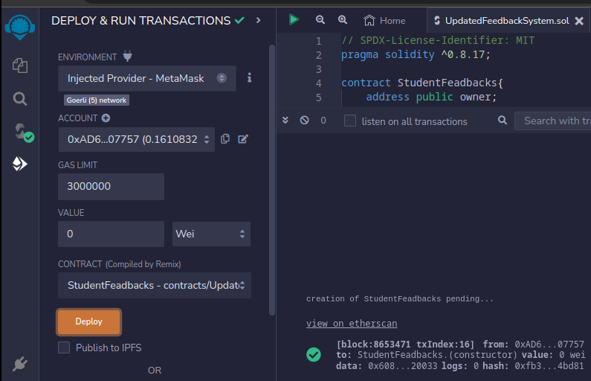
RESULT AND DISCUSSION

Slide 14
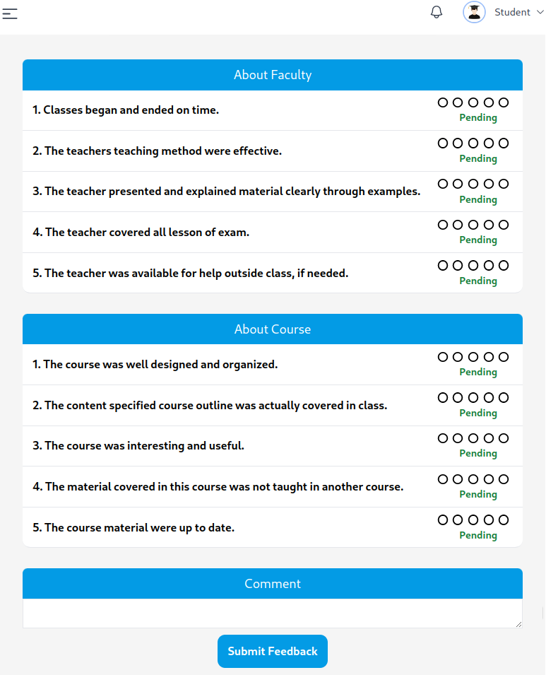
RESULT AND DISCUSSION

Slide 15
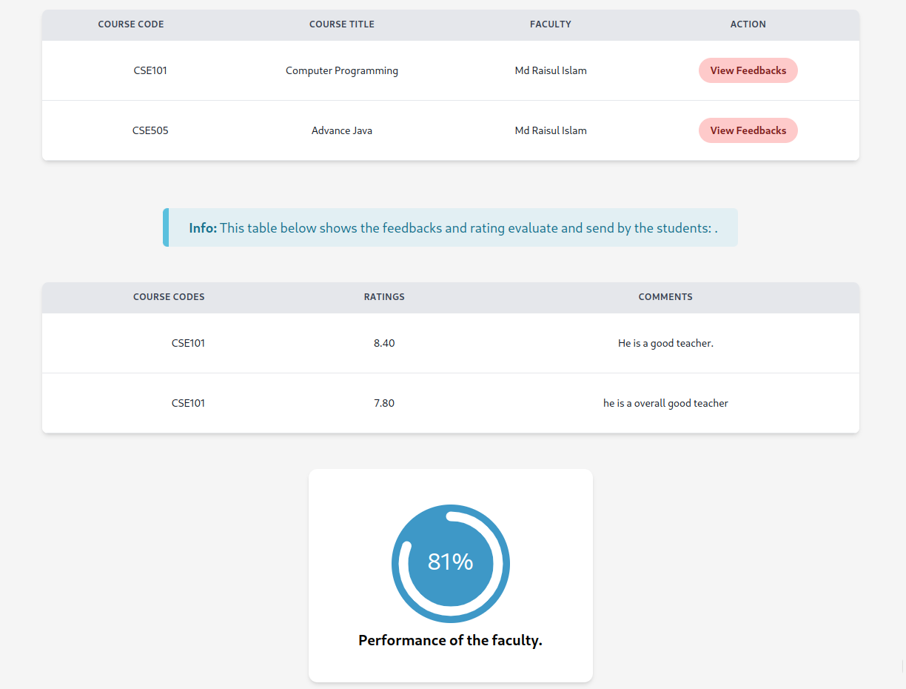
RESULT AND DISCUSSION
https://web3-student-feedback-system.vercel.app

Slide 16
CONCLUSION AND FUTURE WORK
This study investigates how blockchain based feedback system is essential for any organization to ensure the security, privacy ,confidentiality and anonymity.
The knowledge we've gained through this experience can be applied to other feedback systems in future.
This system can be used to develop a survey management, evaluation and rating based system using blockchain.

Slide 17

International Journal of Advanced Computer Science and Applications (IJACSA)
https://thesai.org/Publications/ViewPaper?Volume=14&Issue=10&Code=IJACSA&SerialNo=83
DOI: 10.14569/IJACSA.2023.0141083

Slide 18
Thank You for Listening
Any questions?

Slide 19
REFERENCE
[1] M. Shaker, F. Shams Aliee, and R. Fotohi, “Online rating system development using blockchain-based distributed ledger technology,” Wirel. Networks, vol. 27, no. 3, pp. 1715–1737, 2021, doi: 10.1007/s11276-020-02514-w.
[2] D. Williams, “Australian hotel chain fined $2.2 million for manipulating TripAdvisor reviews.” cnn.com. https://edition.cnn.com/travel/article/australia-tripadvisor-hotel-fined-trnd/index.html (Accessed: 18 Apr 2023).
[3] M. M. Rahman, M. M. H. Rifat, M. Y. Tanin, and N. Hossain, “A feedback system using blockchain technology,” Proc. 3rd Int. Conf. Intell. Sustain. Syst. ICISS 2020, pp. 1114–1118, 2020, doi: 10.1109/ICISS49785.2020.9315989.
[4] A. Chandratre and S. Garg, “Blockchain Based Course Feedback System,” SSRN Electron. J., 2021, doi: 10.2139/ssrn.3762332.
[5] T. Karode and W. Werapun, “Performance Analysis of Trustworthy Online Review System using Blockchain,” 17th Int. Conf. Electr. Eng. Comput. Telecommun. Inf. Technol. ECTI-CON 2020, pp. 510–513, 2020, doi: 10.1109/ECTI-CON49241.2020.9158212.

